Slide 1
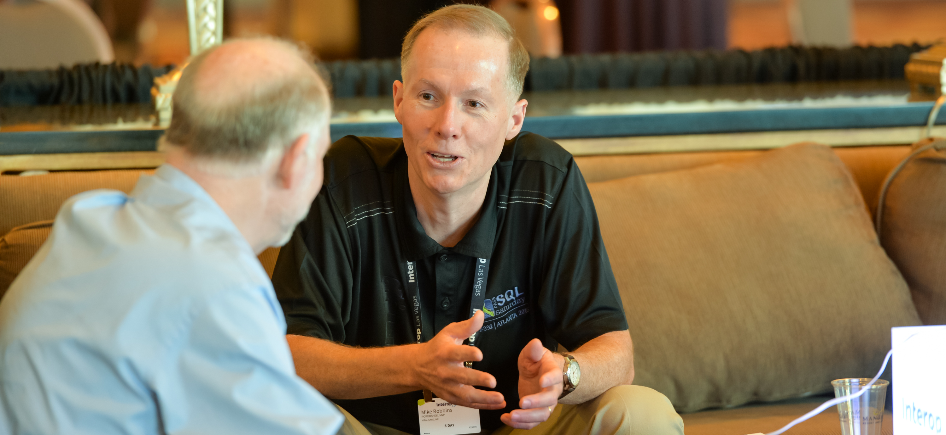


Automate Azure resources at scale with Azure PowerShell
Mike F. Robbins
@mikefrobbins
July 27, 2024

Slide 2




Get-Help –Name 'about_Presenter'
Mike F. Robbins
Lead docs writer for Azure PowerShell at Microsoft

Slide 3

Scenario
Install the Az PowerShell module
Connect to Azure with Azure PowerShell
Manage Azure resources with PowerShell one-liners
Automate creating multiple Azure VMs with a PowerShell script
Use PowerShell best practices

Slide 4

Introduction to Azure PowerShell
Azure PowerShell
The Az PowerShell module
The AzPreview PowerShell module
The AzureRM PowerShell module
The Azure PowerShell module
Azure-related PowerShell modules (not part of Azure PowerShell)
Azure Stack, Entra, Microsoft Graph, MSOnline, AzureAD

Slide 5
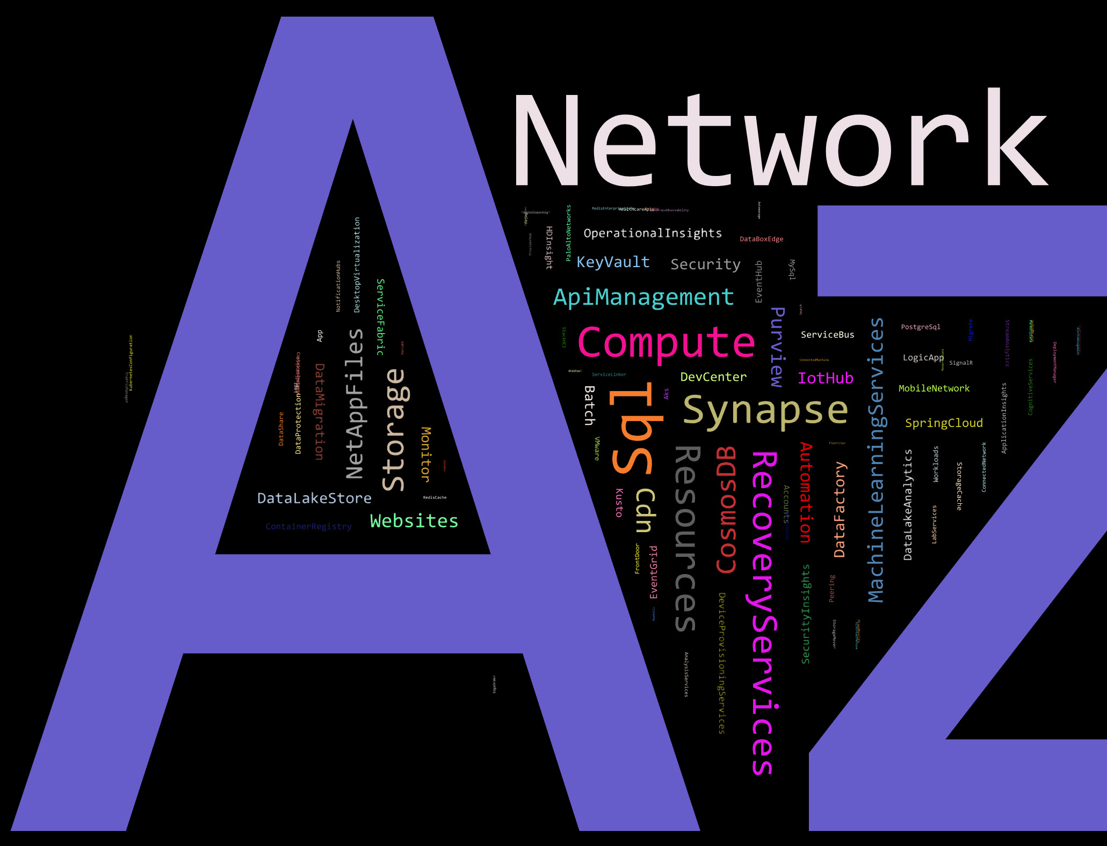
Commands in the Az PowerShell module
Total commands: 7735
Modules: 175

Slide 6

Azure PowerShell Support lifecycle
Follows Semantic versioning (major.minor.path)
Major versions – Breaking changes
Minor versions – Backwards compatible updates
Patch versions – Security fixes
Module version types
Generally available (GA)
Preview
Feature preview
Az versus AzPreview module

Slide 7

Azure PowerShell Support lifecycle (more)
Release cadence
Support of releases
Standard term support (STS)
Long term support (LTS)
Breaking changes
Supported environments

Slide 8

Getting Started with Azure PowerShell
Prerequisites
An Azure subscription
Options for using Azure PowerShell
Azure Cloud Shell
Web browser
Windows Terminal
Local installation
A Windows, Linux, or macOS system
PowerShell 7 (Windows PowerShell 5.1 is also supported)
Docker container

Slide 9

Authentication
Interactive
Connect-AzAccount
New login experience
Configure default subscription for login
Web Account Manager (WAM)
Browser based authentication
Device code authentication
Noninteractive
Service principal
Managed identity

Slide 10

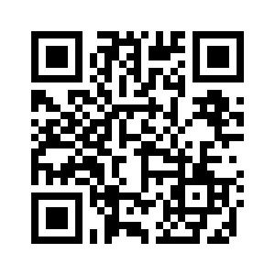
Start-Process 'Demo'
Create resources interactively
Create resources at scale
Demo Code: github.com/mikefrobbins/Presentations

Slide 11

Get-Contact –Identity 'Presenter'
Blog: mikefrobbins.com
Twitter: @mikefrobbins
LinkedIn: www.linkedin.com/in/mikefrobbins
GitHub: github.com/mikefrobbins

Slide 12


